Slide 1


Driver Booking System
Submitted by:
2021:Ayush Sisodia
2103:Mudit Tiwari

Slide 2
ABSTRACT
The Driver Booking system can be use by customers to book drivers for their cars instead of searching drivers offline we provide drivers online with the customers need.
This System is enable by the internet which connects the customers with the drivers .
As per this system customer visits the website, browses through the various drivers, they can search driver by pin code, check the car type that particular driver is expert in and book their desire driver.
Customers can book driver according to their requirement, they can book driver for shot ride,long trip, or for going market etc.

Slide 3
INTRODUCTION
Travelling is also a major part of day-to-day activities and in same case also, people want same comfort assistance in whole journey.
Taking this statement, we came to the solution that will provide the comfort as well as secure journey provided.
Driver Booking is a web application which lets you book Driver for the intercity and intra-city travel purpose using your browser and provides you the best service that will make your journey more luxurious.

Slide 4
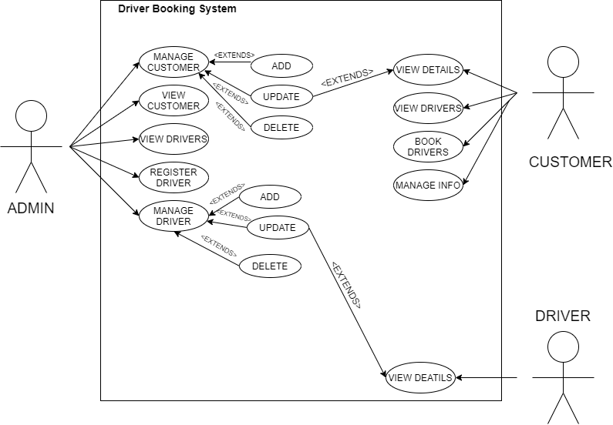
USE CASE DIAGRAM

Slide 5
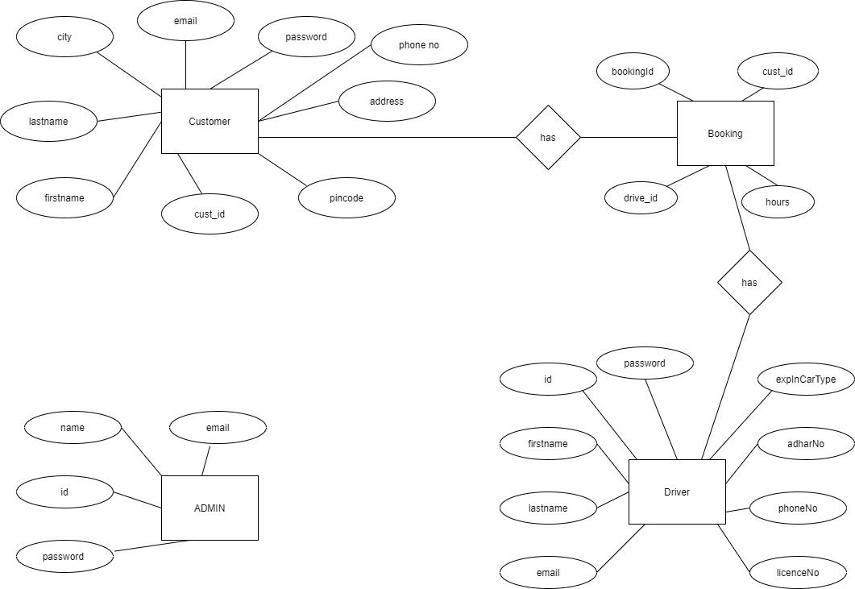
E-R DIAGRAM

Slide 6
PURPOSE
Login for Admin
Manage customer list
Manage driver list
Customer login
Register customer
Register driver
Book a driver
Customer booking confirmation

Slide 7
SCOPE
This system will allow customer as well as driver to register themselves. This system will all the user to Book driver for their car.
Our drivers are highly trained and professional. Information will be share with each other on the process of booking. Our driver are easy to reach.
We provide drivers that are near your area.

Slide 8
FEATURES
Online registration
Simple, fast and convenient driver booking.
Availability of service 24x7.
Customers can Book driver according to car-type.
Customers can search driver through pin code, which provide driver near their area.
An online Booking system ready to be viewed by people.

Slide 9
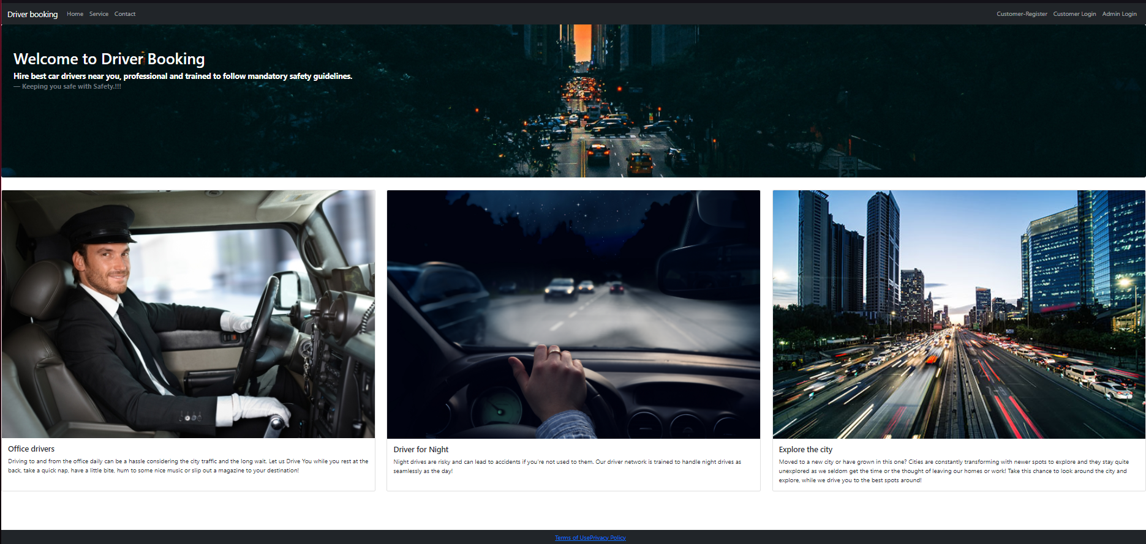
INTERFACES HOME-PAGE:

Slide 10
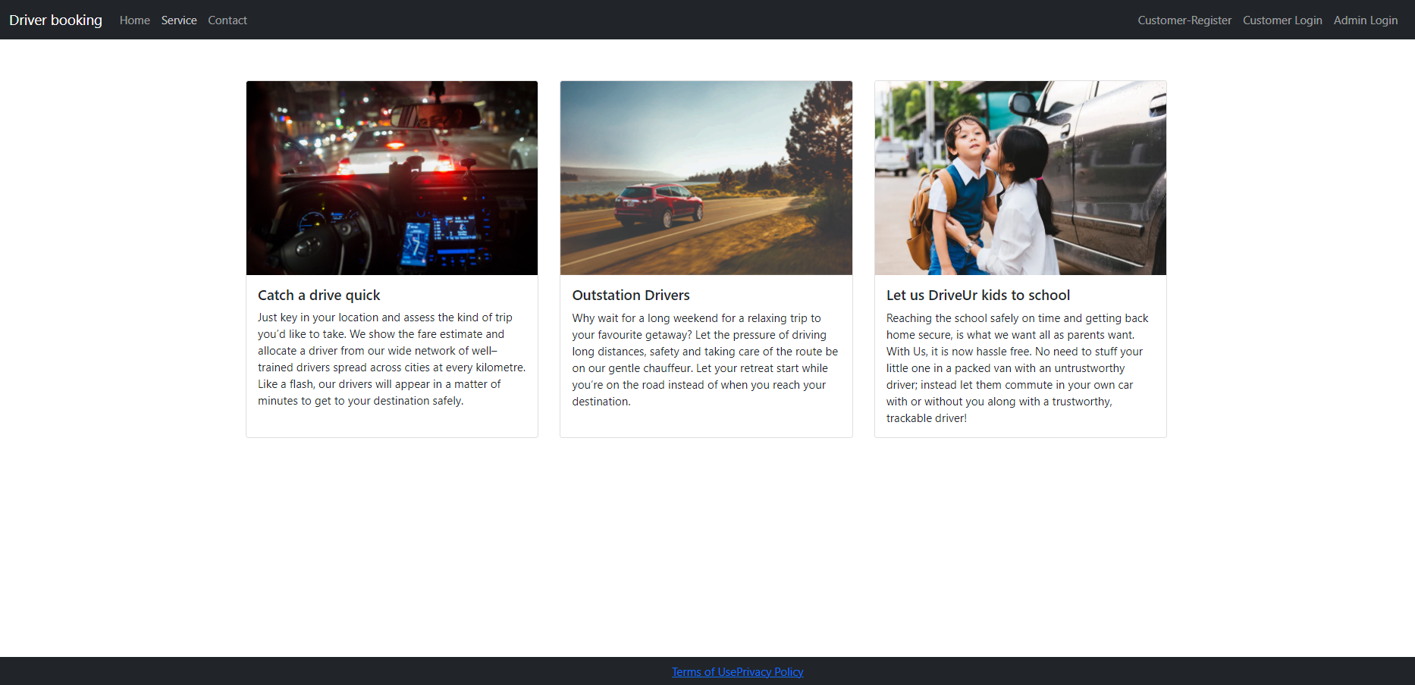
SERVICE:

Slide 11
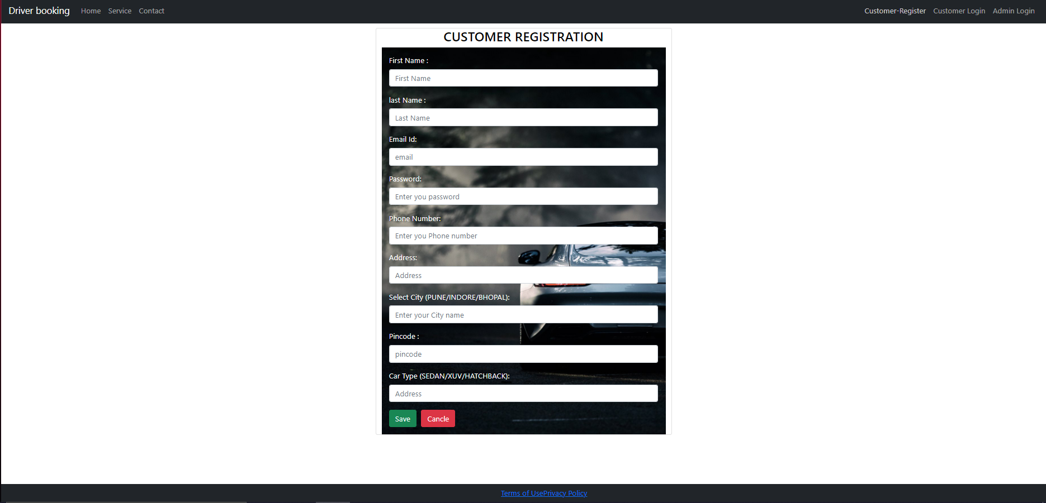
CUSTOMER REGISTRATION:

Slide 12
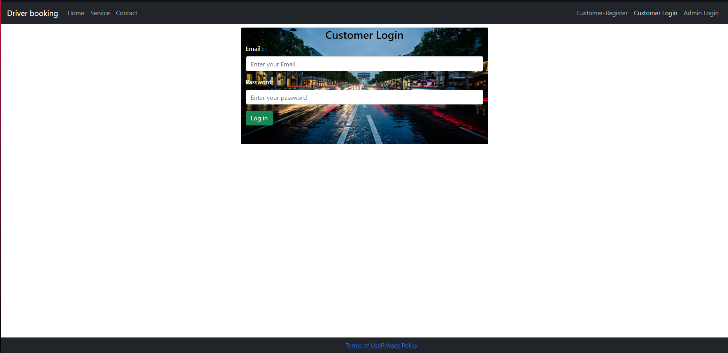
CUSTOMER-LOGIN:

Slide 13
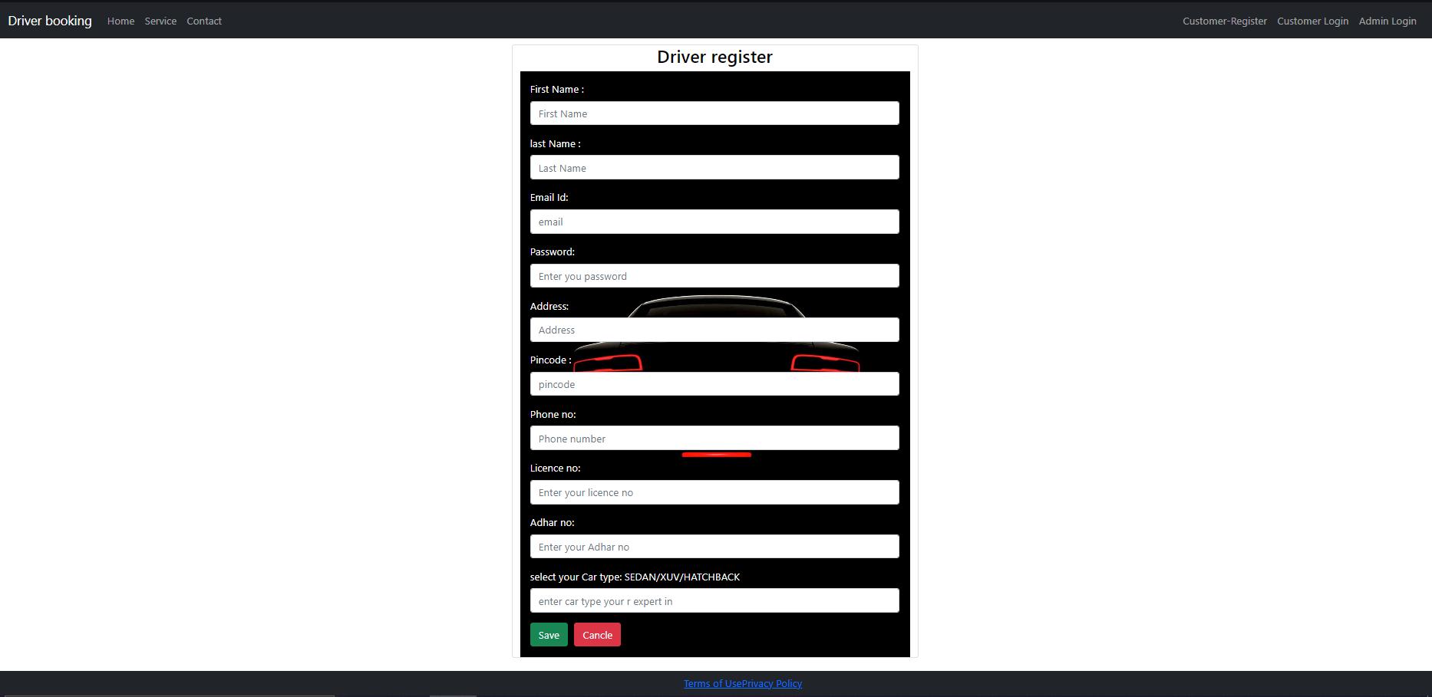
DRIVER REGISTRATION:

Slide 14
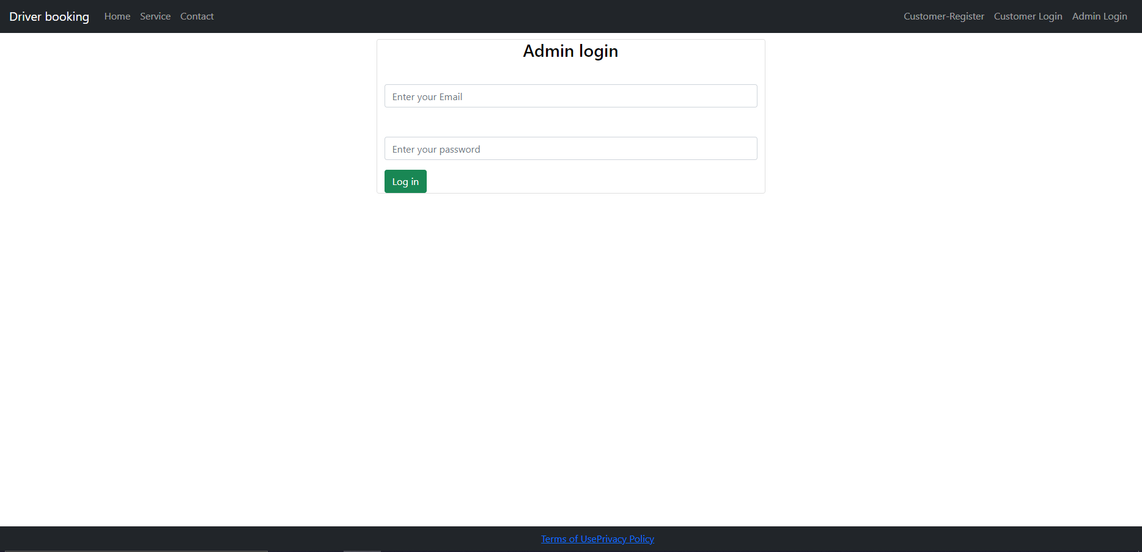
ADMIN LOGIN:

Slide 15
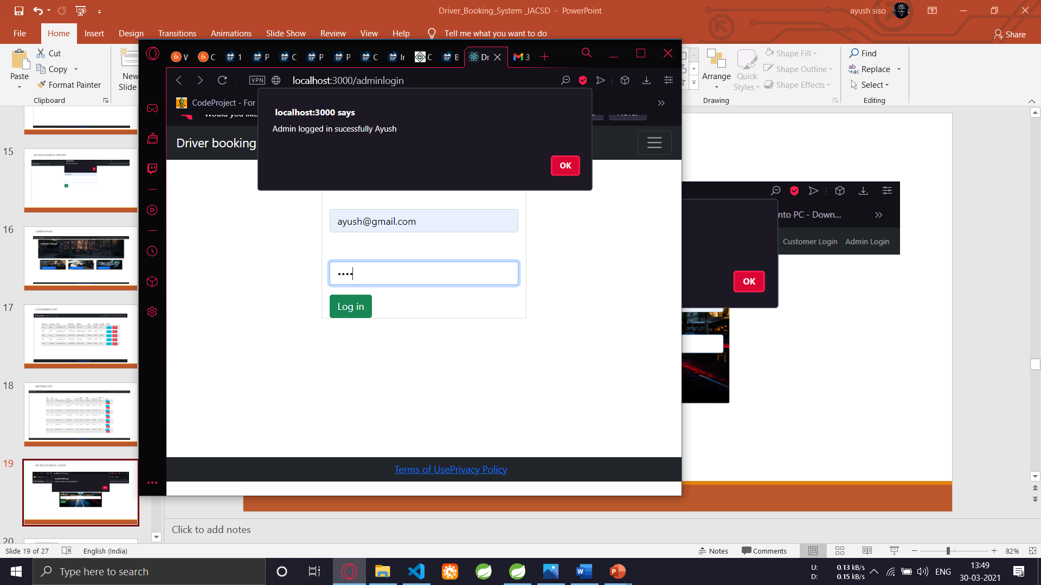
ON SUCCESSFUL ADMIN ONLINE:

Slide 16
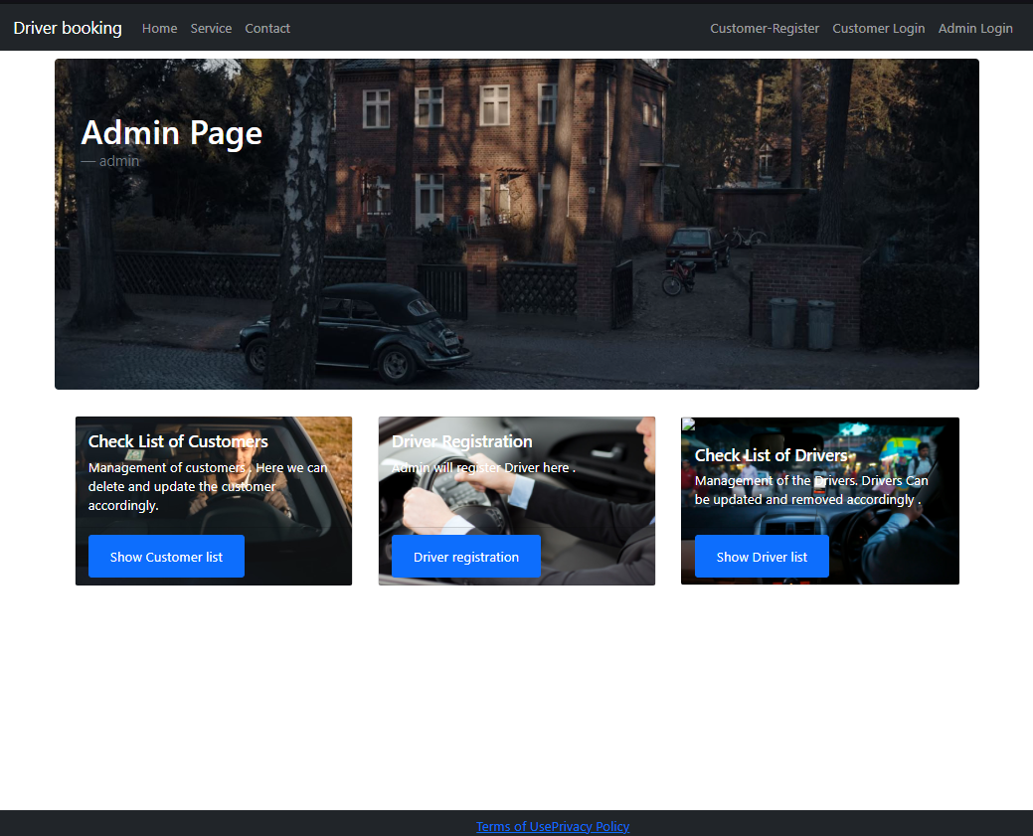
ADMIN-PAGE:

Slide 17
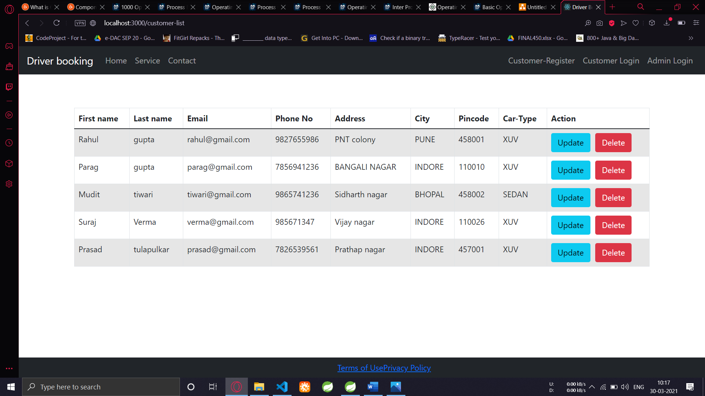
CUSTOMER-LIST:

Slide 18
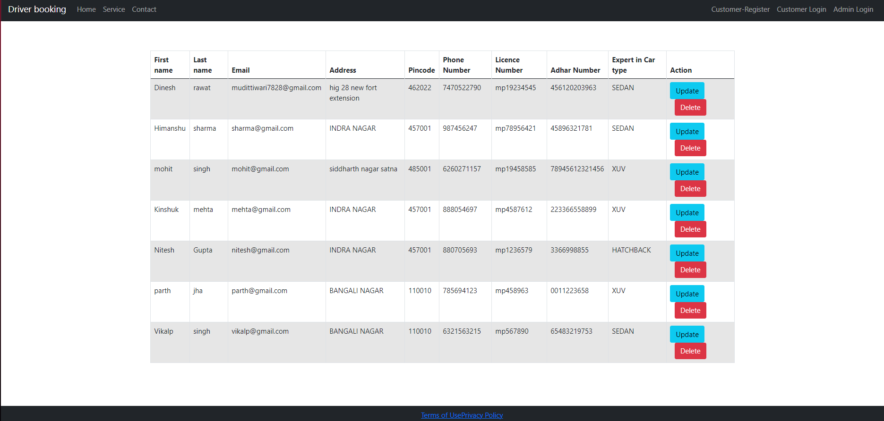
DRIVER-LIST:

Slide 19
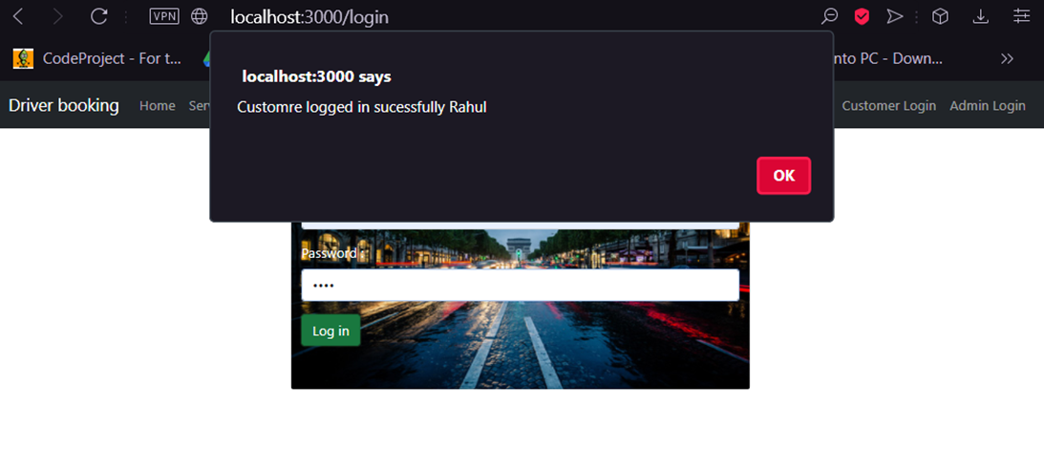
ON SUCCESSFUL LOGIN:

Slide 20
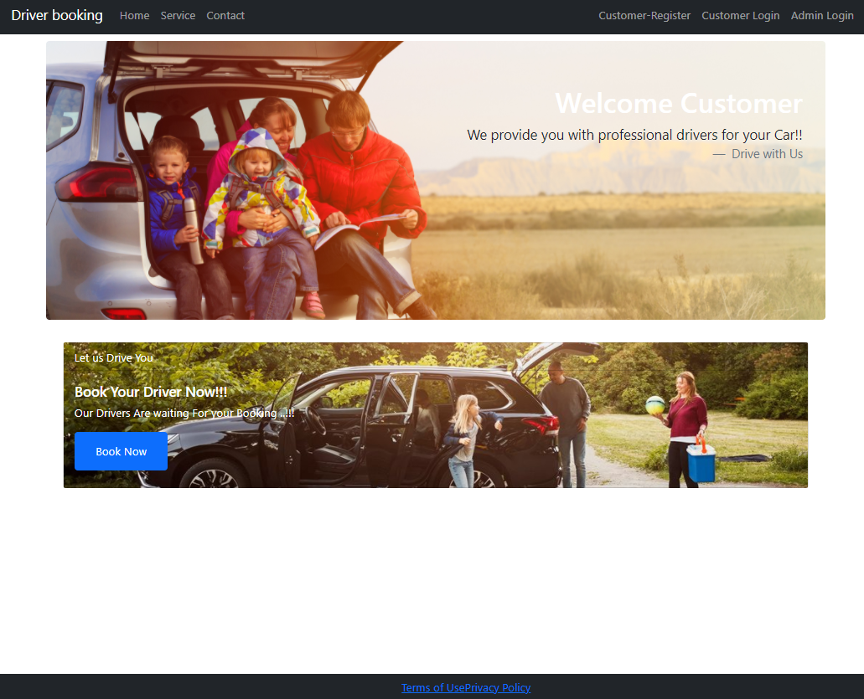
CUSTOMER-PAGE:

Slide 21
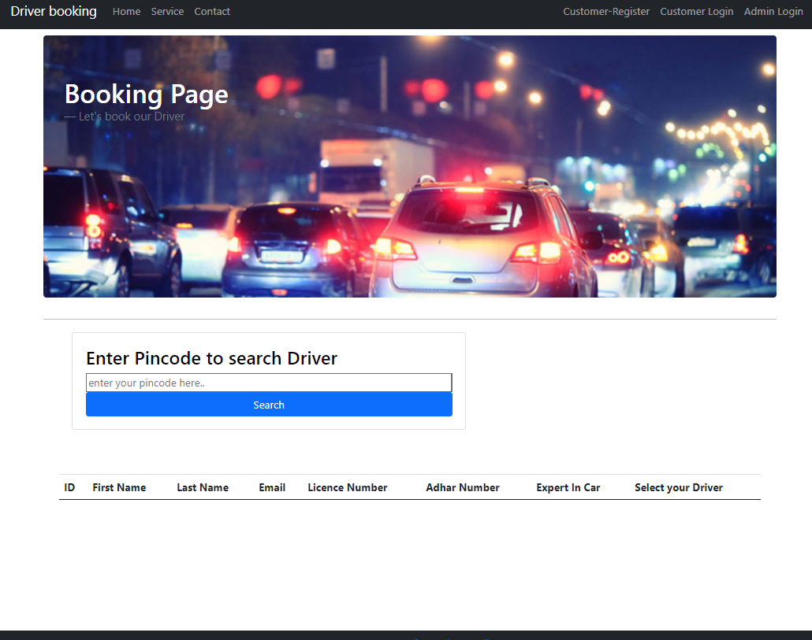
BOOKING-PAGE:

Slide 22
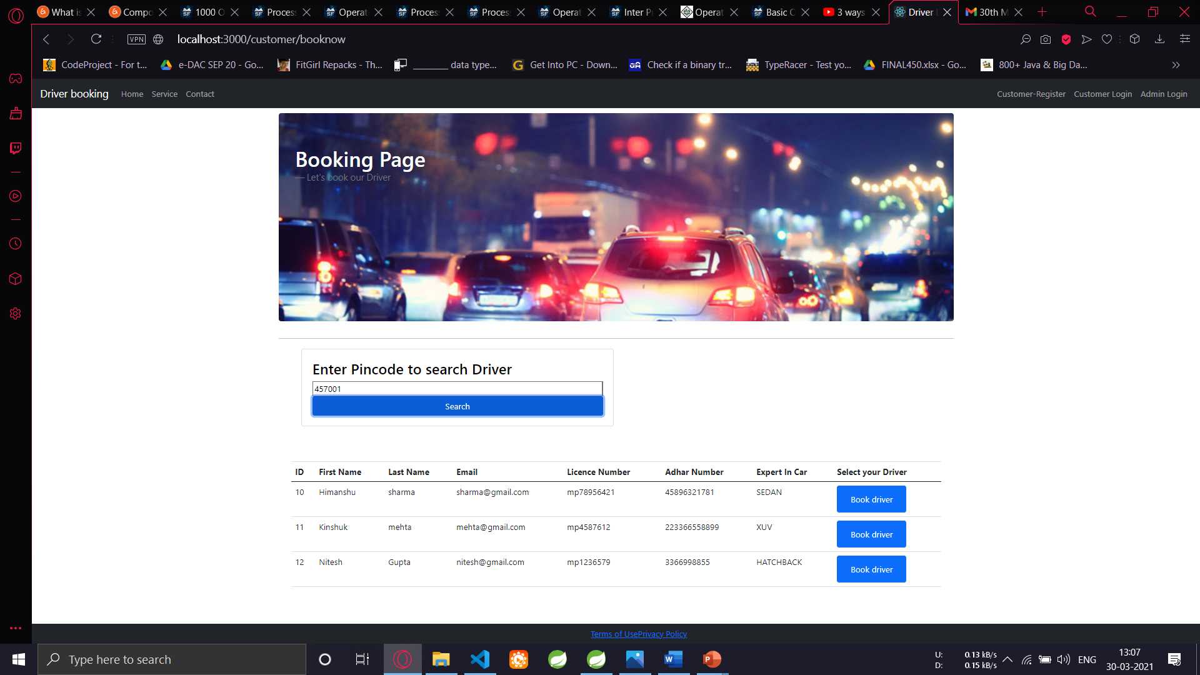
SEARCHING BY PINCODE:

Slide 23
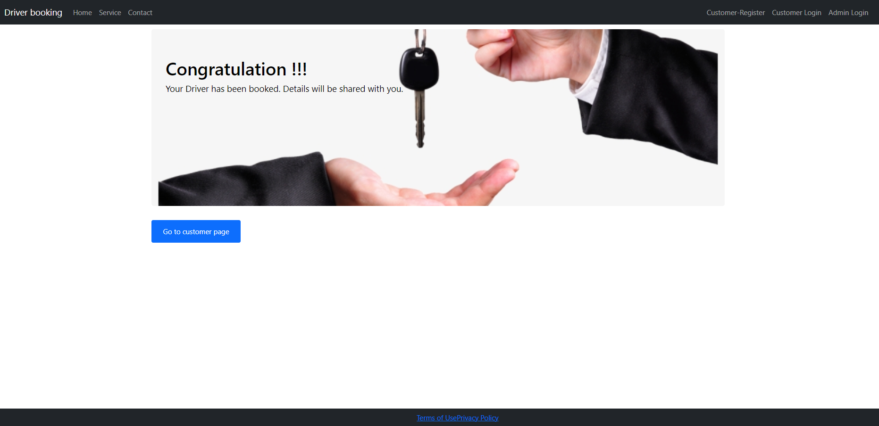
ON SUCCESSFUL BOOKING:

Slide 24
FUTURE SCOPE
In future the proposed update feature of Driver booking allows the user associates to track the current status of the journey.
Also, we would like to evaluates the remaining time till the passenger reaches its destination.
The Driver tracking feature is appreciated widely everywhere, at the time of emergencies such as accidents, the tracking device will trigger an alarm that will simultaneously inform the attendants about the incident & thereby asking for help.

Slide 25
CONCLUSION
After reviewing our work, the conclusion is that after many adjustments the system works. As good as it is now, there can still be made many adjustments/improvements. However in the time was given that four persons can work on this project, the overall results are satisfactory in our opinion. The report covers the entire course of the project and results are there were needed. This conclusion chapter is more a description of the process rather than a summary to give all results and facts.
The first few days the work progressed slower than expected, in the last days the pace was increased to finish on time. At several moments, the progress and pace was commented on that "the progress was not good". The results of this report should be sufficient evidence that work was done properly.
The conclusion as it is now hopefully gives a understanding in the steps taken to make the report.

Slide 26
SOFTWARE REQUIREMENT
WINDOWS 10
MySQL DATABASE
SPRING TOOLS
VISUAL STUDIO CODE

Slide 27
HARDWARE REQUIREMENT
Processor -Intel® Core™ i5-9300H CPU @2.40GHz
Ram-8 GB
MEMORY-500 GB

Slide 28
REFERENCES
https://reactjs.org
https://react-bootstrap.github.io
https://reactrouter.com
https://www.mysql.com

